Slide 1
Unlocking Funding for IPC’s Registered Apprentice Program
February 21, 2024

Slide 2

A Registered Apprenticeship Overview
Employer Involvement
Structured On-the-Job Learning
Technical Instruction
Rewards for Skill Gains
National Credential
  Fostering workforce development through registered apprenticeships.

Slide 3


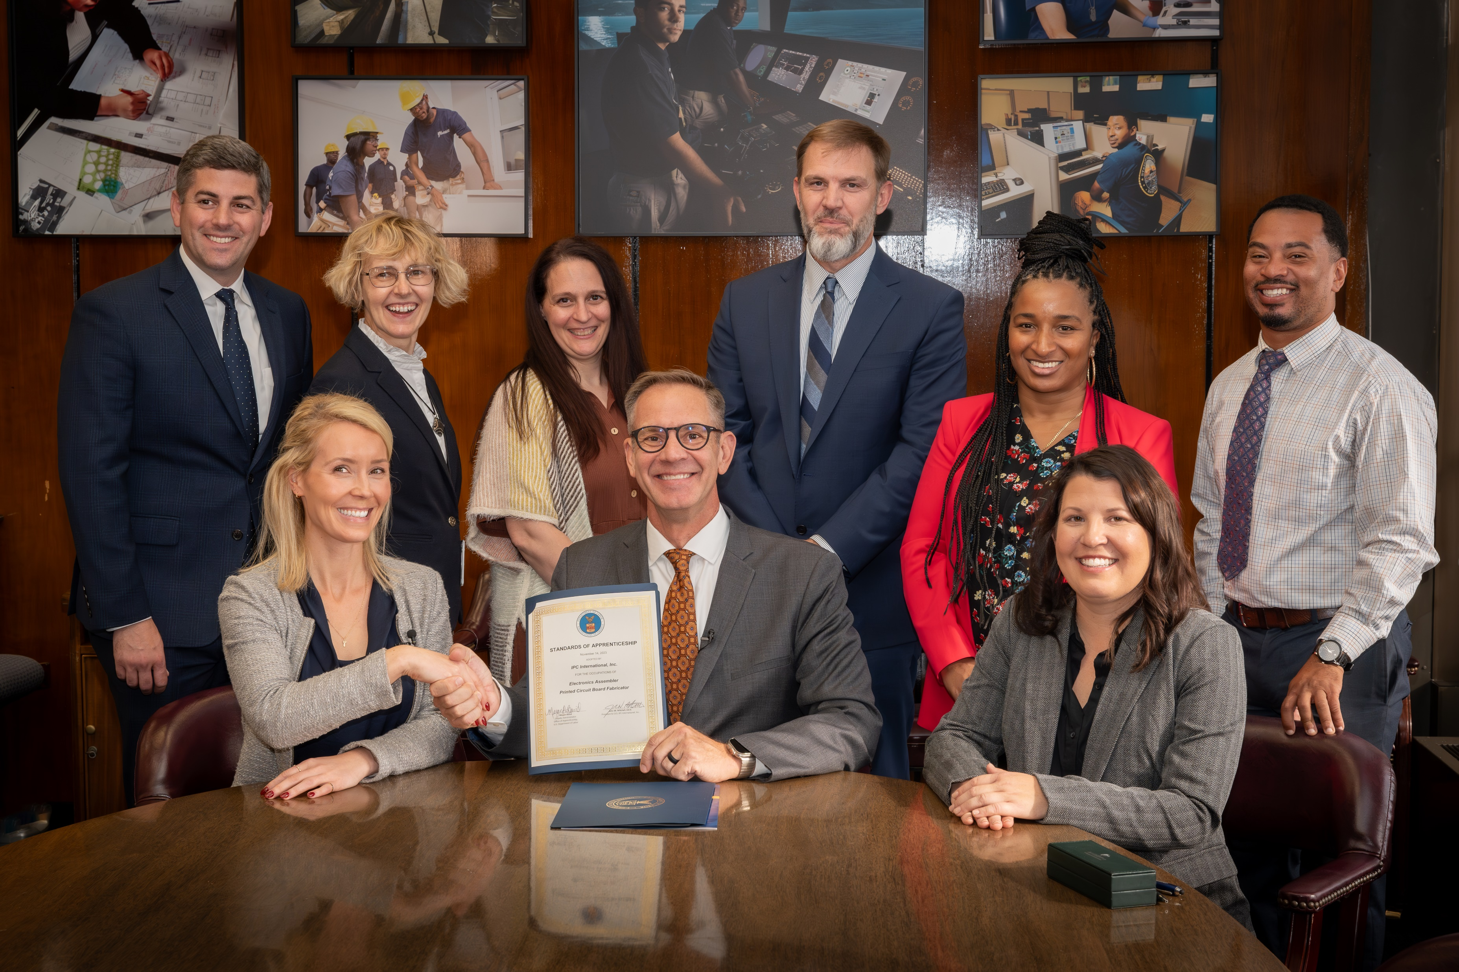

IPC’s Registered Apprenticeship Program
Benefit individuals and organizations within the electronics manufacturing value stream with
US Department of Labor Recognition.
Offer specific apprenticeship programs tailored to industry needs.

Slide 4
Federal, State and Local Funding Landscape
Providing resources for skills development and workforce training
US Department of Labor
Employment and Training Administration
The Workforce Innovation and Opportunity Act
Participating States
Local Workforce Boards
Community Based Programs
Workforce Service Providers

Slide 5
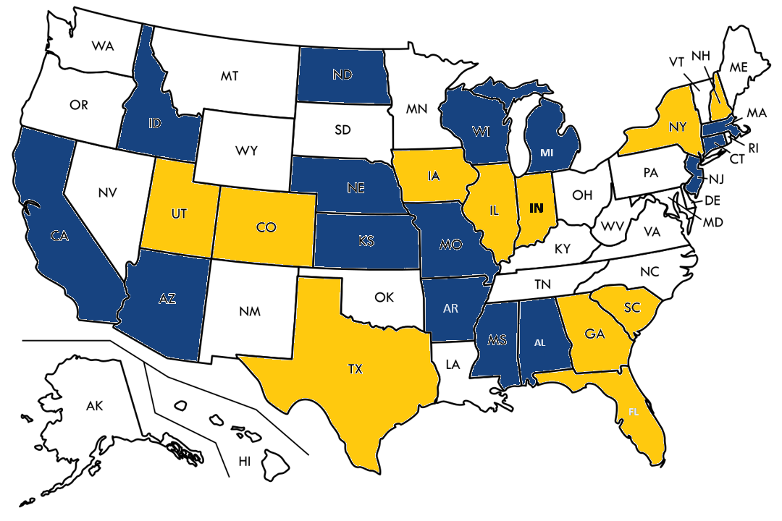
Eligible Provider Training List Status
IPC Registered Apprenticeship on state ETPL ​
​
Coordinating addition of IPC Registered Apprenticeship on state ETPL

Slide 6



Technical Assistance for Employers
Supporting employers in implementing and sustaining apprenticeship initiatives
  Incentive funding opportunity for first-time program launches on a per apprentice basis.
  The grant provides $375 per apprentice.
  The second grant provides full RTI costs equal to $500 for each apprentice. This has a very limited window (through May).
  These opportunities can be braided.
Offering guidance and resources for successful program development

Slide 7

IPC’s Impact
We’ve credentialed more than 300,000 individuals to work in electronics manufacturing facilities.
The IPC Education Foundation has fostered the completion of introductory courses by 4,000 college students; the exposure of 6,000 high school and college students to industry skills; and the distribution of $250,000 in scholarships and awards.
Since 2018, the U.S. electronics industry has added more than 75,000 jobs, exceeding our projection by 50%.
We have built portable, stackable, competency-based and industry-recognized workforce programs. These programs are establishing career pathways that facilitate upskilling and professional growth.

Slide 8
Questions and Answers
What burning questions or insightful reflections do you have about the presentation that can spark a vibrant discussion?
✓
?

Slide 9
For More Information
General Apprenticeships:
https://www.ipc.org/ipc-apprenticeships
Electronics Assembler Apprentice Program:
https://www.ipc.org/electronics-assembler-apprentice
Funding:
https://www.ipc.org/workforce-training-apprentice-funding
National Apprenticeship Week 2023 Report:
2023-NAW-Report-FNL-010824-508.pdf

Slide 10


Next Steps ~ Contact Information
Victoria Hawkins, M.A.Ed.
Director, Workforce Grants and Proposals
VictoriaHawkins@ipc.org
Cory Blaylock, M.S.S.E
Director, Workforce Partnerships
CoreenBlaylock@ipc.org

