Slide 1

Unlocking Success with IPC Workforce Training
Presenters:
Mike Hoyt, IPC Workforce Training Advisor
Kelly Lawrence, IPC Account Manager

Slide 2

Which of these challenges apply to you?
Skills gap for new hires continues to get larger
All our sites are on different pages
Training to IPC standards can be tough for a new hire
Hiring and retaining people is more challenging today
Our current training is outdated. Content is not engaging
What other challenges do you face? Please share in the chat.
Notes:
We need training resources that:
teach employees how to do their job with proficiency.
are interactive and engaging.
allow for faster training, reduce learning time (and cost)
incorporate best learning practices, for better learning.
Can be plugged into our training process and scaled across our organization

Slide 3
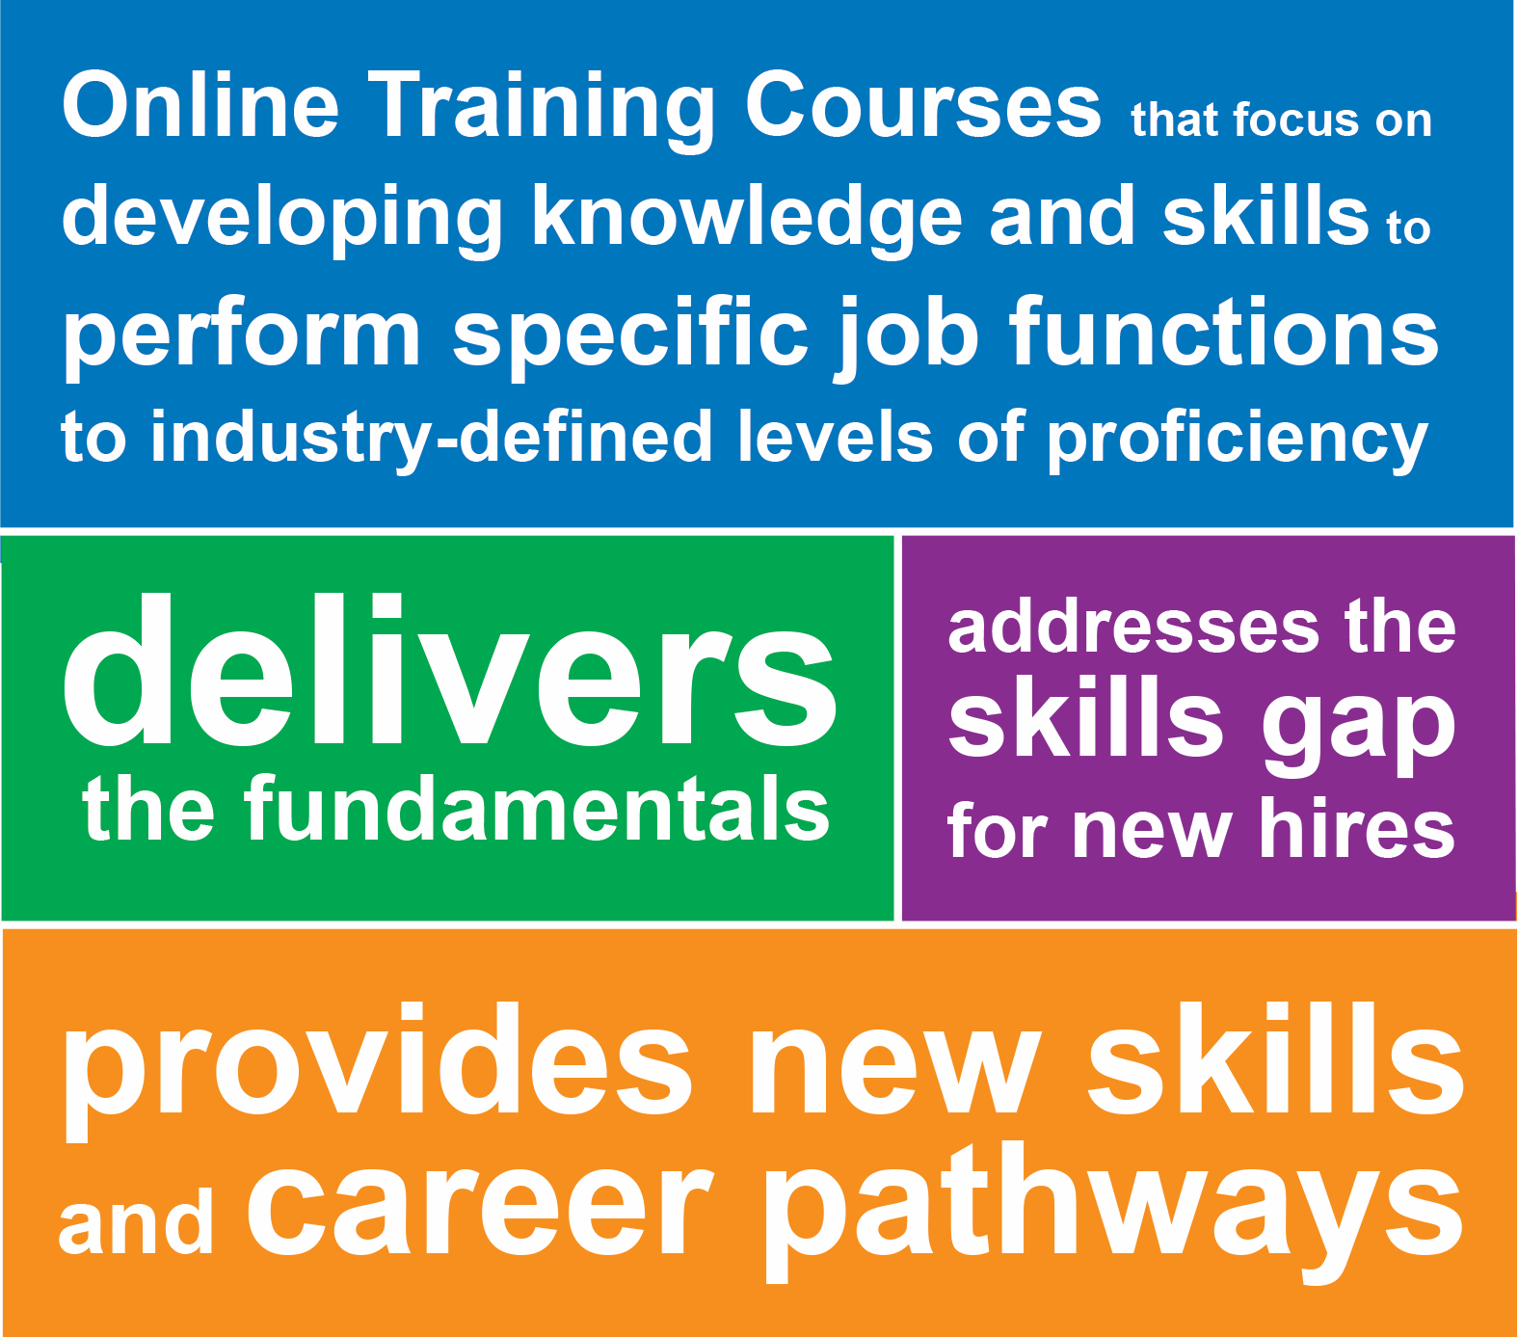

What is Workforce Training (WFT)
Online demo
Notes:
Training programs that focus on developing knowledge and skills to perform specific job functions to industry-defined levels of proficiency.
These courses address the skills gap for new hires who come to you with little or zero experience.
They also provide new skills and career pathways for existing employees.

Slide 4
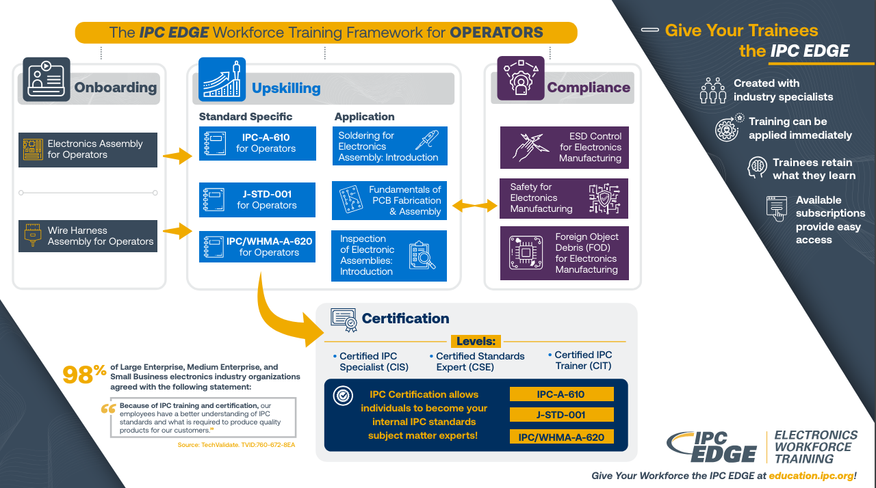
Workforce Training Framework - Pathways

Slide 5
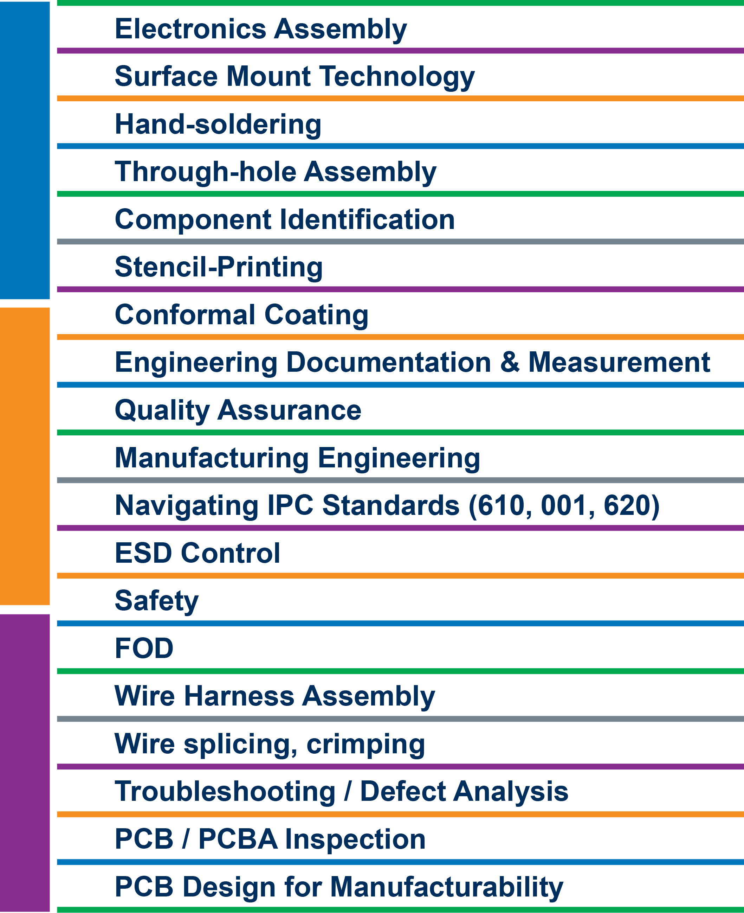

Some Examples of Training Content Included

Slide 6


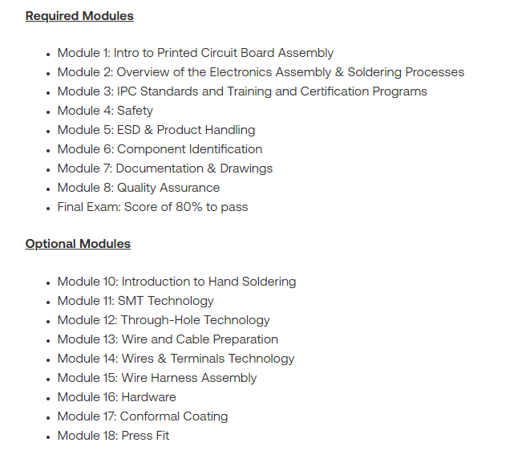
Flexible Implementation
Online, self-paced format allows students to work at their own pace, without an instructor.
This allows the training to be specific to the individual and their learning needs.
This also allows trainers to focus their valuable time on higher level learning, hands-on application and individualized support where learners are struggling.
Can be customized to organizations needs, using a combination of mandatory and optional modules
Available 24/7 via web browser
Notes:
Focused on the individual, not a one-size fits all approach
Customized to organization’s needs: Required and Optional Modules
Close Captioning available for special needs and Language issues

Slide 7
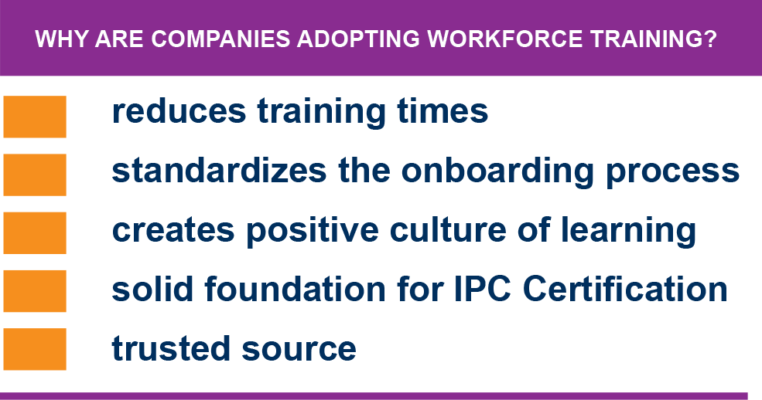
Outcomes from Workforce Training (WFT)
Notes:
Why are companies adopting Workforce Training?
It reduces training times – Companies using WFT have cut onboarding training times by one-third. Get your people to proficiency faster. You save money
It standardizes the onboarding process throughout the entire organization, while offering an individual learning experience
It creates a positive culture of learning and show your people you want them to succeed
Provides effective measuring tool for new hires
It creates a solid foundation before any OJT and makes future certification process easier for students and trainers. In fact, Companies using WFT have reported better passing scores for certification.
Trusted source: These courses are built by the same certifying body that develops the industry standards and issues certifications.
What our customers like about it
Engaging content. Courses are interactive, with current images, videos, activities and assessments.
Students actually retain their learning better and longer.
Flexible implementation
You can see / track student progress.
Students receive valid IPC certificate upon course completion.

Slide 8
Workforce Training Certificate Example
Certificate not Certification (Similar to a Diploma)
User’s Name
Only Lists Modules Completed
Valid for Two Years/ Refresher or CE Training
Unique ID/ Validation

Slide 9
Let’s take a deeper look
Evaluating courses
Admin features
Purchasing options
Questions?

Slide 10

White Paper from IPC Education
IPC’s plan to address the electronics manufacturing industry’s workforce challenge focuses on developing a comprehensive strategy to bridge the growing skills gap and counteract the labor shortage exacerbated by demographic shifts and changing worker expectations. IPC’s plan aims to not only address immediate labor market needs but also ensure the long-term sustainability and growth of the electronics manufacturing industry by building a skilled, adaptable, and motivated workforce.
Creating an Industry-Driven Talent Pipeline
Implementing Career Pathways Systems
Investing in Effective Training and Education
Promoting Awareness and Dispelling Myths
Fostering Collaboration and Support
Utilizing Standardized Credentials

Slide 11

Thank You!
Stay up to date at education.ipc.org
If you have any questions, please contact:
  Mike Hoyt, Workforce Training Advisor mikehoyt@ipc.org
  Kelly Lawrence, Account Manager
  kellylawrence@ipc.org

